Slide 1
Node.js Performance Monitoring Clinic.js
Subramanian Murugan

Slide 2
Session Agenda
What is Performance Monitoring

Slide 3
Why is App slow?

Slide 4

Because bottleneck

Slide 5
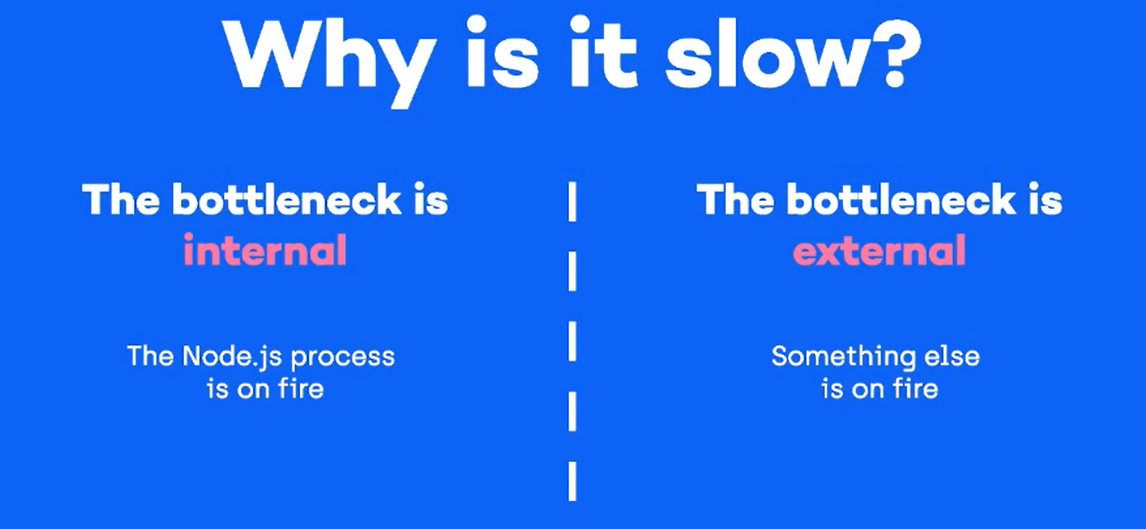

Slide 6
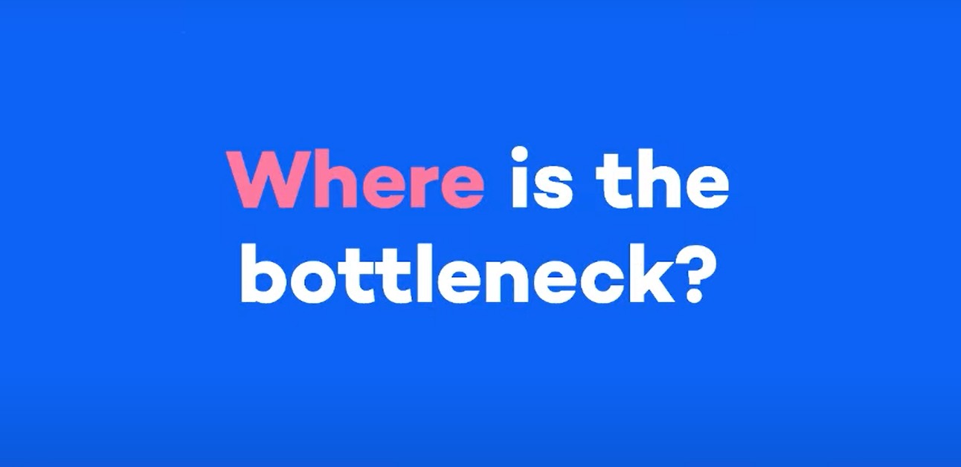

Slide 7
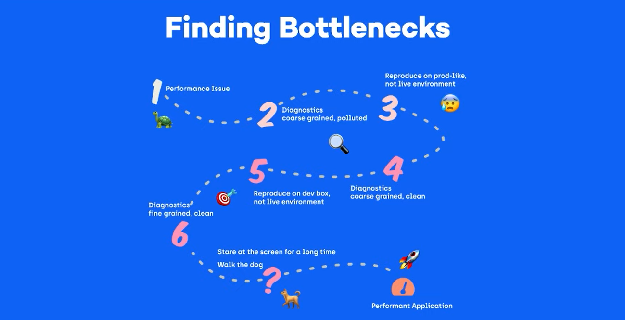

Slide 8
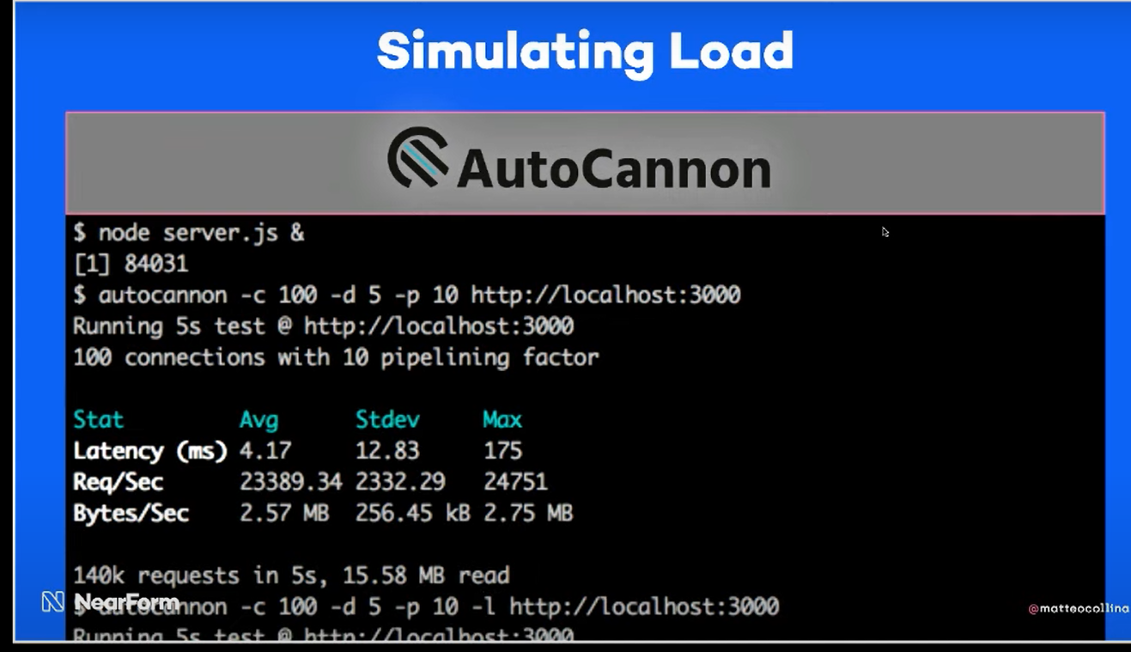

Slide 9
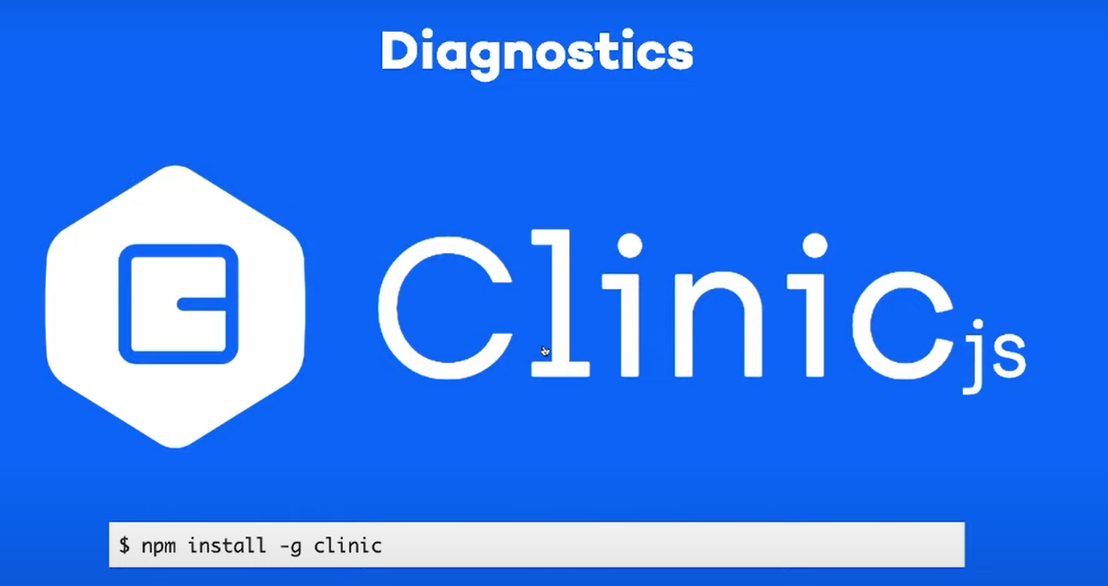

Slide 10
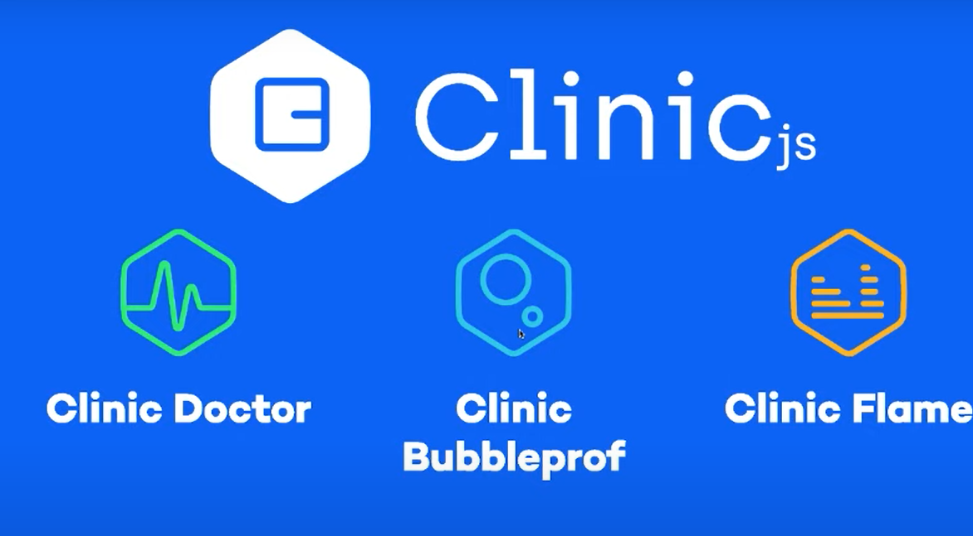

Slide 11
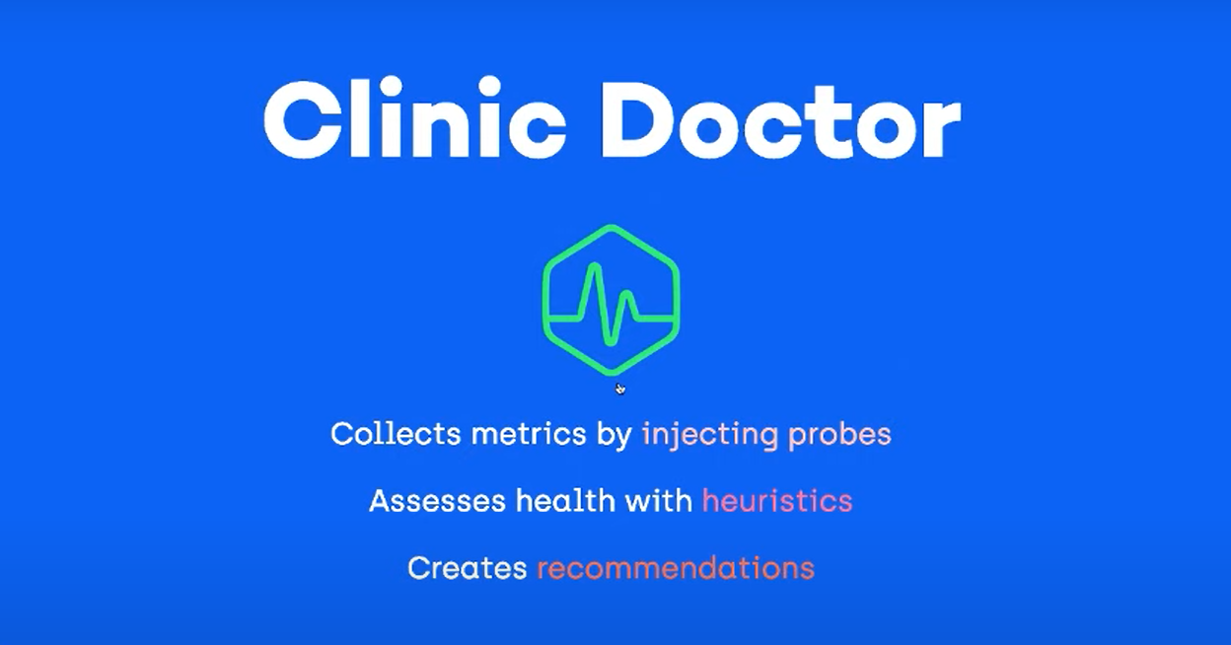

Slide 12
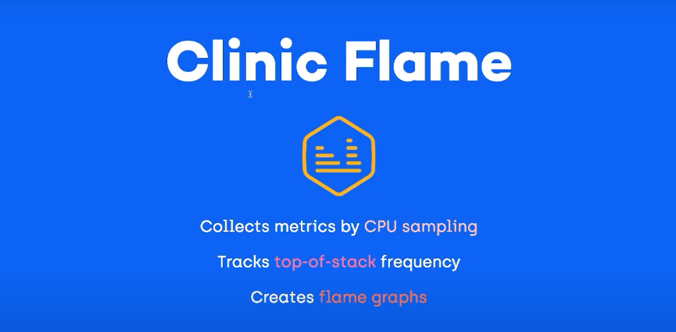
Notes:
CPU sampling takes a snapshot of what is running at a set interval without noticeably slowing down your program. The aggregation of these snapshots gives us an estimate of how long the functions in your program are taking to execute.

Slide 13
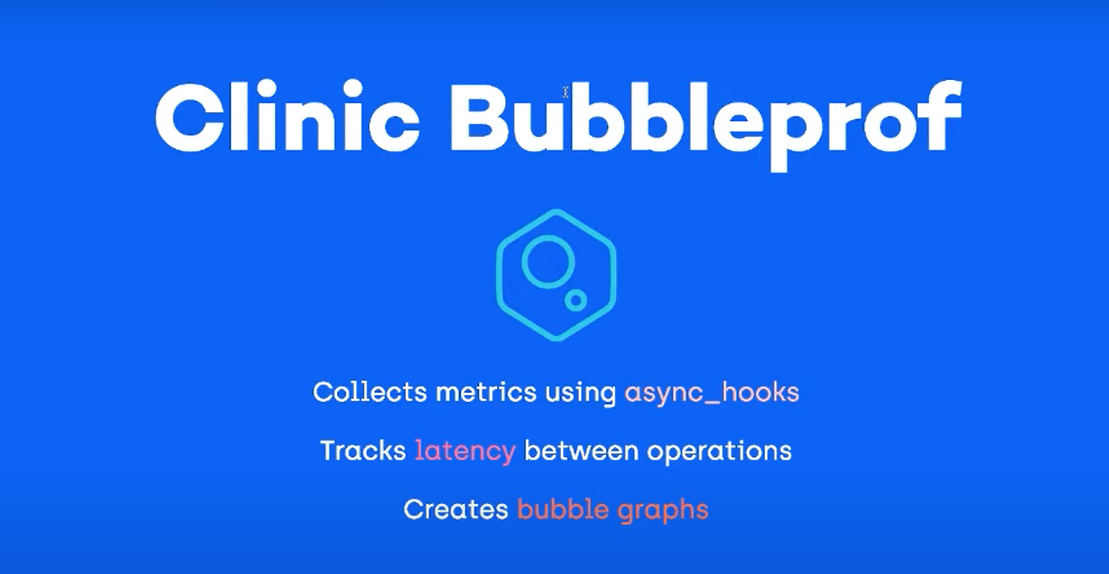

Slide 15
Ask Docker, Docker recommends You

Slide 16
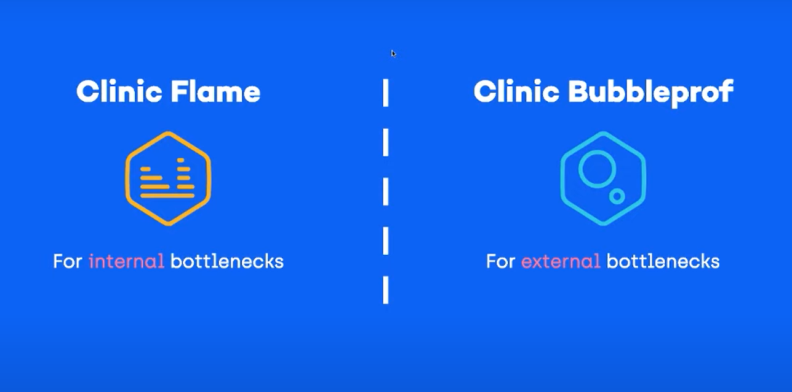
Docker Recommendations

